Slide 1


Slide 2
BPUG Introduction
Main Objective: Create a strong local community in Basel/Switzerland!
Twitter: #BPUG
Blog: http://powershelldistrict.com/category/bpug
Facebook (Group): https://www.facebook.com/groups/845881005485255/
Facebook (Page): https://www.facebook.com/PowerShellDistrict

Slide 3
Save the date!
Next BPUG Meeting → Wednesday 24/02/2016
Claudio Spizzi → Deploying SCOM Using PowerShell DSC
?? → Open for speakers

Slide 4
Agenda
Stefan Roth – End to end Automation Using PowerShell and Service Manager
Stéphane van Gulick – Introduction to PowerShell 5.0 classes: practical use case using PowerShell classes

Slide 5
Stefan Roth
End to end Automation Using PowerShell and Service Manager

Slide 6
Stephane van Gulick
Introduction to PowerShell 5.0 Classes and practical use case

Slide 7
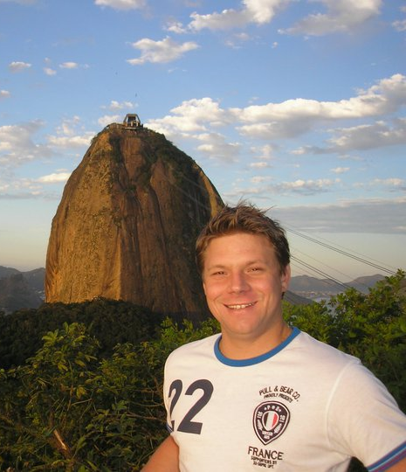



Stephane van Gulick
Stephane van Gulick
Microsoft MVP, PowerShell Hero, Founder of the Basel PowerShell User group (BPUG)
Multiple Microsoft certifications (MCITP, MCSA) Work Primarly with Configuration manager and PowerShell (But automate anything that has Powershell on it!)
PowerShell Hero
Microsoft PowerShell MVP
http://PowerShellDistrict.com

Slide 8
Agenda
A short history of PowerShell Objects
Basic syntax for PowerShell Classes: Properties, Methods, Constructors
Advanced Syntax/Concepts: Enums, Constructor Overloads, Inheritence
Practical use case

Slide 9
Demo Time!

Slide 10
A few words on our Sponsors

Slide 11


Sponsors

Slide 12
Save the date!
Next BPUG Meeting → Wednesday 24/02/2016
Claudio Spizzi → Deploying SCOM Using PowerShell DSC
?? → Open for speakers ;)

Slide 13
BPUG Introduction
Twitter: #BPUG
Blog: http://powershelldistrict.com/category/bpug
Facebook (Group): https://www.facebook.com/groups/845881005485255/
Facebook (Page): https://www.facebook.com/PowerShellDistrict

